Slide 1
How to Save Results
Here a simple guide on how to save results

Slide 2
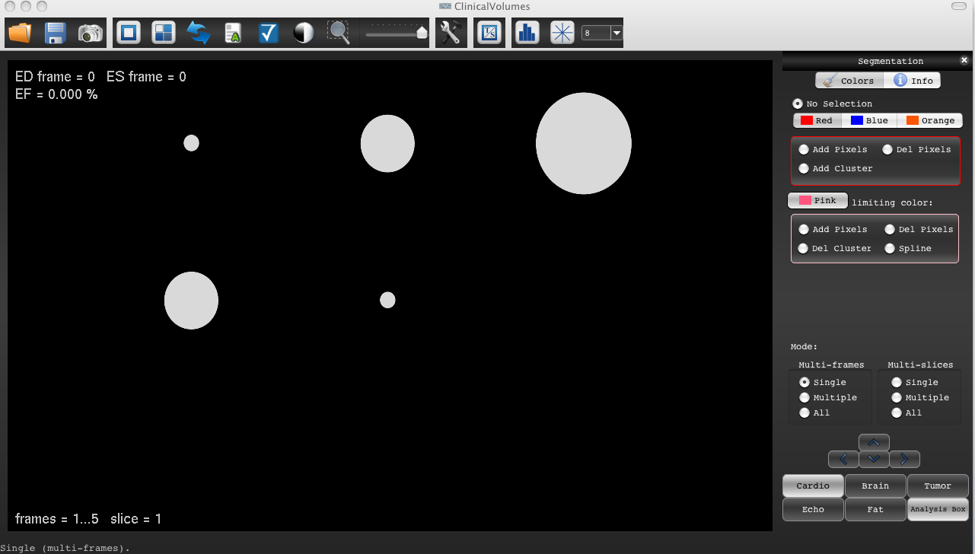
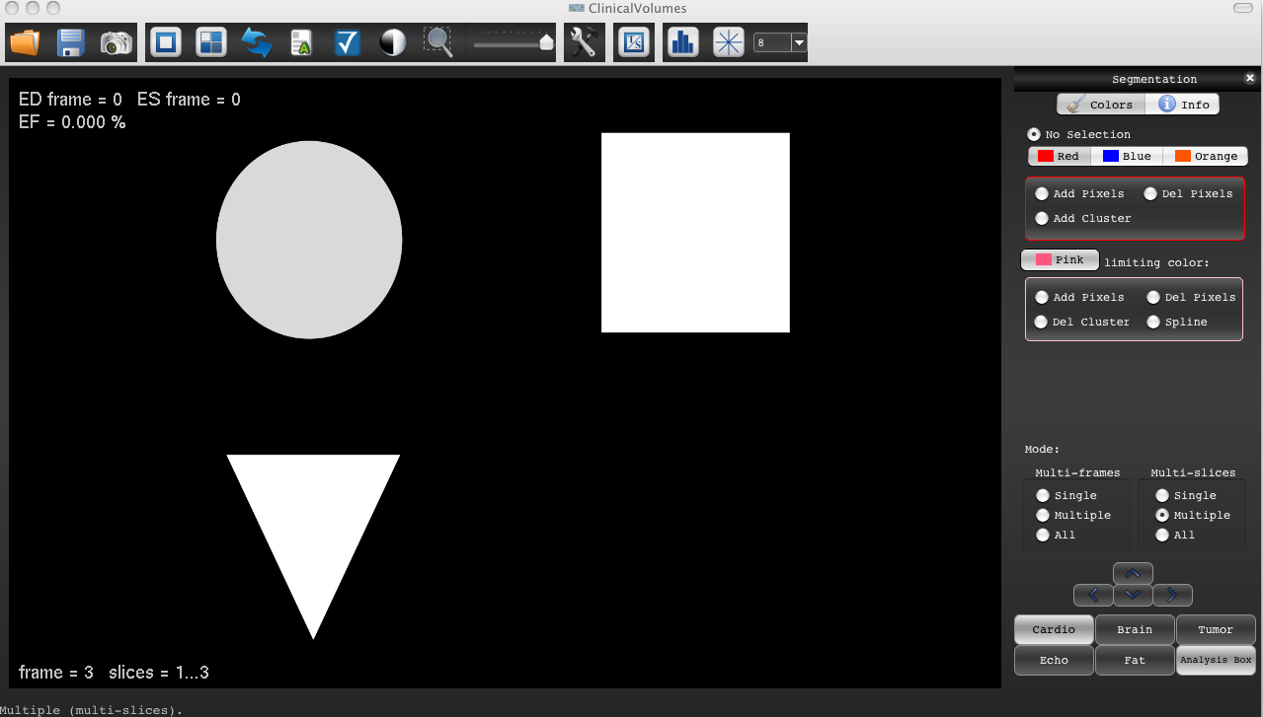
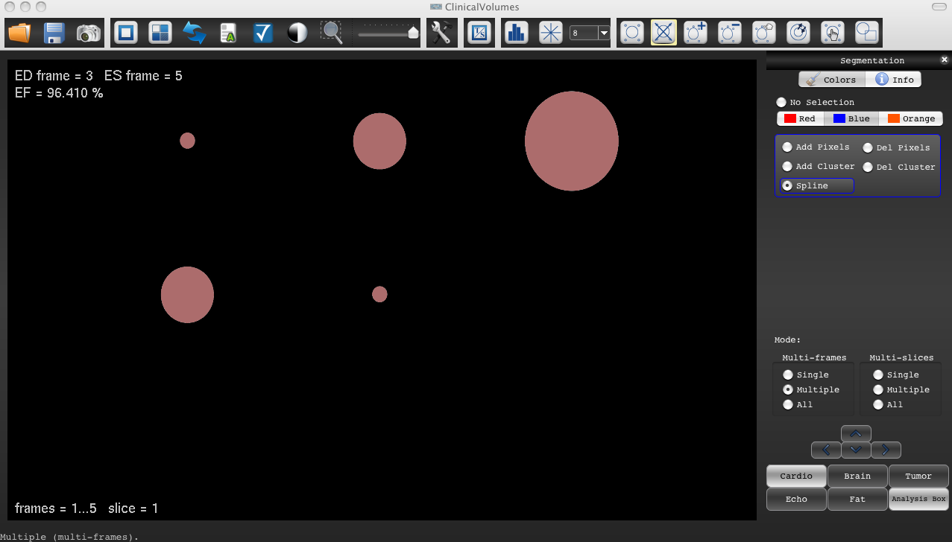
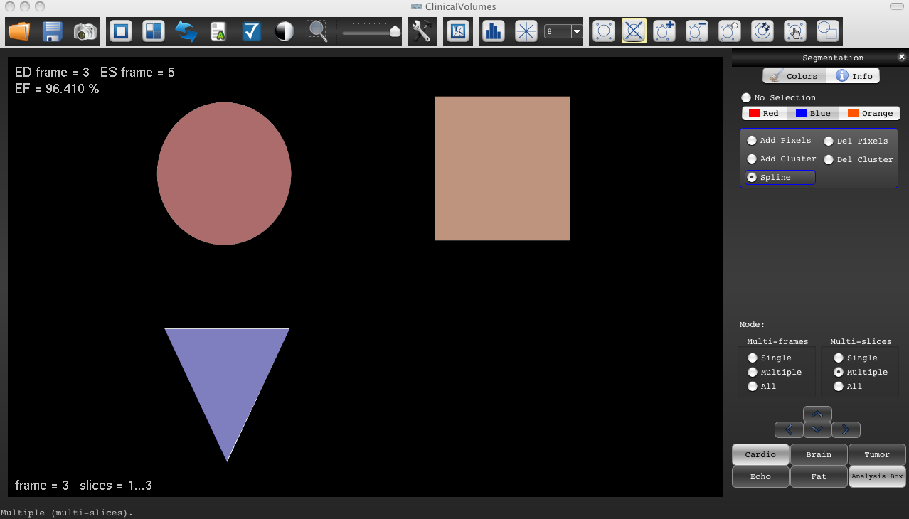
In this example, a dataset formed of 5 frames and 3 slices (3 different geometrical forms) is reported
Open the dataset of 5 frames , 3 slices
Segment the dataset with 3 different colors, one for each slice.
Save the results using the command “Save results“

Slide 3
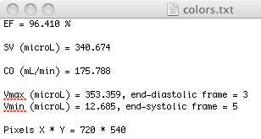
4) Open the saved result file
Ejection fraction, Stroke volume and Cardiac output, relevant to cardiac studies, see “The use of Cardio segmentation”
Volume max (Vmax) and Volume min (Vmin) identify the biggest and smallest total volume frame respectively .
Number of pixel in the X and Y direction

Slide 4

The Total volume (volume tot) in mm3 represents the sum of the volumes in all the slices of a single frame:
Volume tot (frame) = (cluster area slice1 + cluster area slice2 + cluster area slice3) * slice thickness
The total volume is not color specific. Only the limiting colors are not accounted in such calculation
The total volume is representative of each frame of the dataset in mm3.
In this particular dataset we have 5 frames and therefore 5 values. Red, Orange and Blue clusters are sum together.
Frame 1 all slices
Frame 2 all slices
Frame 3 all slices
……….

Slide 5
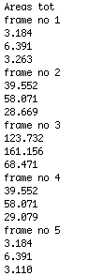
The Total area (Areas tot) in mm2 represents the sum of the segmented areas of each frame and slice as:
Areas tot (ex: frame1 slice1) = area cluster red + area cluster orange+ area cluster blue
The Areas tot results are not color specific. Only the limiting colors are not accounted in such calculation.
Slice 1
Slice 2
Slice 3
Slice 1
This section identify the total areas respective to each frame and slice of the dataset in mm2.
Remember that such areas are not color specific. All the clusters included in the frame are here summed.
Slice 2
Slice 3
Slice 1
Slice 2
Slice 3
Slice 1
Slice 2
Slice 3
Slice 1
Slice 2
Slice 3

Slide 6
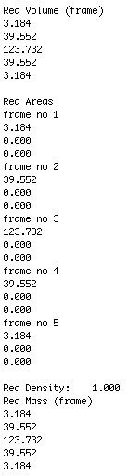
The volume of the Red color (Red volume) in mm3 represents the sum of the Red volumes presented in all the slices of a specific frame.
Note that the Red Volume is color specific.
The limiting color is not accounted in such calculation
Slice 1
Slice 2
Slice 3
The Red Areas (in mm2) represent the sum of the red clusters of each frame and slice
The Red volumes can be multiplied by a density factor. In this example it was maintained as 1. See “Extra features -> Mass Calculation option”

Slide 7
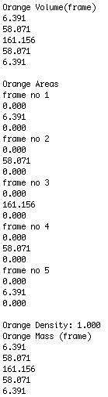
The volume of the Orange color (Orange volume) in mm3 represents the sum of the Orange volumes presented in all the slices of a specific frame.
Note that the Orange Volume is color specific.
The limiting color is not accounted in such calculation
Slice 1
Slice 2
Slice 3
The Orange areas (in mm2) represent the sum of the orange clusters of each frame and slice
The Orange volumes can be multiplied by a density factor. In this example it was maintained as 1. See “The use of the Mass Calculation option”

Slide 8
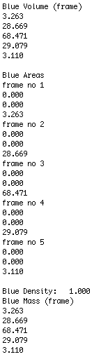
The volume of the Blue color (Blue volume) in mm3 represents the sum of the Blue volumes presented in all the slices of a specific frame.
Note that the Blue Volume is color specific.
Slice 1
Slice 2
Slice 3
The Blue areas in mm2 represent the sum of the blue clusters of each frame and slice
The Blue volumes can be multiplied by a density factor. In this example it was maintained as 1. See “The use of the Mass Calculation option”

